Slide 1
UNIT- IV DOMAIN ANALYSIS

Slide 2
CONTENTS
Overview of Analysis
Domain Class Model
Domain State Model
Domain Interaction Model
Iterating the Analysis

Slide 3
Domain Analysis
Domain Analysis is concerned with
Devising a Precise, concise, understandable and correct model of real world.
During analysis, build models and find
requirement analysis

Slide 4
Overview of Analysis
System Conception
Generate Requests
Users
Developers
Managers
Problem Statement
Build Models Class Model
User Interview State Model
Domain knowledge Interaction Model
Real world Experience

Slide 5
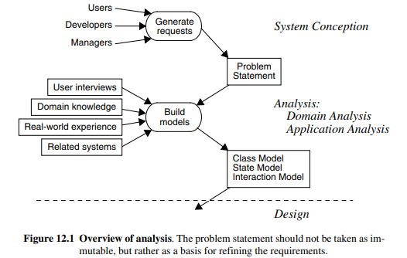

Slide 6
Overview of analysis
The analysis model addresses the three aspects of objects: static structure of objects (class model), interactions among objects (interaction model), and life-cycle histories of objects (state model).
We have divided analysis into two substages. The first, domain analysis, is covered in this chapter and focuses on understanding the real-world essence of a problem. The second, application analysis, is covered in the next chapter

Slide 7
Domain Class Model
The first step in analyzing the requirements is to construct a domain model.
The domain model describes real-world classes and their relationships to each other.
Find classes and associations first, as they provide the overall structure and approach to the problem.
Next add attributes to describe the basic network of classes and associations.
Then combine and organize classes using inheritance
Operations are usually unimportant in a domain model. The main purpose of a domain model is to capture the information content of a domain

Slide 8
The steps to be performed to construct a domain class model
• Find Classes.
• Prepare a data dictionary.
• Find associations.
• Find attributes of objects and links.
• Organize and simplify classes using inheritance.
• Verify that access paths exist for likely queries.
• Iterate and refine the model.
• Reconsider the level of abstraction.
• Group classes into packages

Slide 9
Domain Class Model: Finding classes
The first step in constructing a class model is to find relevant classes for objects from the application domain.
Objects include physical entities, such as houses, persons, and machines, as well as concepts, such as trajectories, seating assignments, and payment schedules.
All classes must make sense in the application domain; avoid computer implementation constructs, such as linked lists and subroutines.
Avoid computer Implementation
Noun Phrase Approach
Requirement Sources--→ Extract Nouns--→
Tentative Classes--→ Eliminate Irrelevant
classes---→ Classes

Slide 10
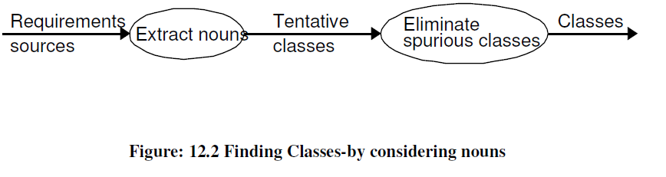
Finding classes
As Figure 12.2 shows, begin by listing candidate classes found in the written description of the problem

Slide 11
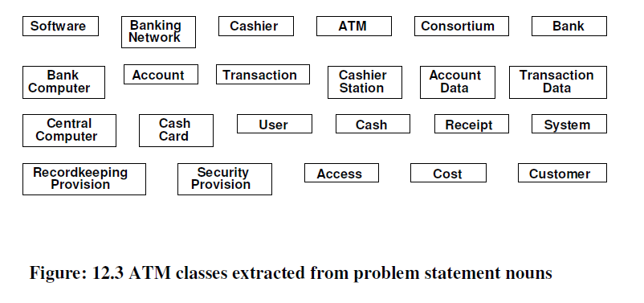
Finding classes

Slide 12
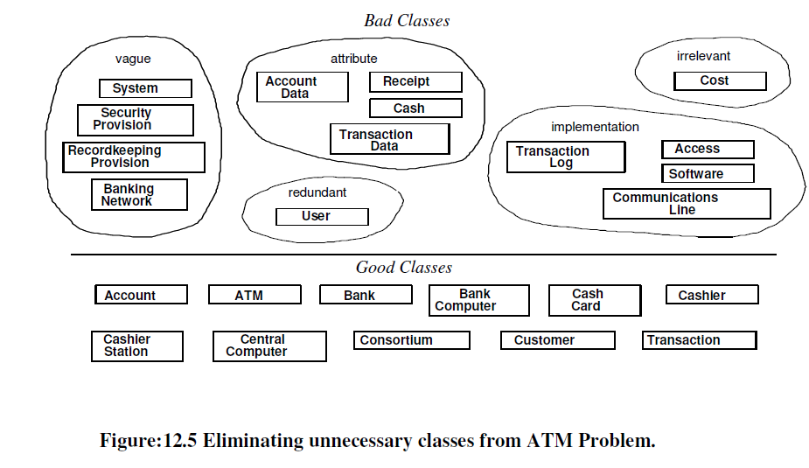
Keeping the right classes

Slide 13
Keeping the right classes
Redundant classes: If two classes express the same concept, you should keep the most descriptive name. For ATM example. Customer and User are redundant; we retain Customer because it is more descriptive.
Irrelevant classes. If a class has little or nothing to do with the problem, eliminate it. This involves judgment, because in another context the class could be important. ATM example. Apportioning Cost is outside the scope of the ATM software.
Vague classes. A class should be specific. Some tentative classes may have ill-defined boundaries or be too broad in scope. ATM example. RecordkeepingProvision is vague and is handled by Transaction. In other applications, this might be included in other classes, such as StockSales, TelephoneCalls, or MachineFailures.
Attributes: Names that primarily describe individual objects should be restated as attributes. For example, name, birthdate, and weight are usually attributesATM example. AccountData is underspecified but in any case probably describes an account. An ATM dispenses cash and receipts, but beyond that cash and receipts are peripheral to the problem, so they should be treated as attributes.

Slide 14
Keeping the right classes
Operations. If a name describes an operation that is applied to objects and not manipulated in its own right, then it is not a class. For example, a telephone call is a sequence of actions involving a caller and the telephone network. An operation that has features of its own should be modeled as a class, however. For example, in a billing system for telephone calls a Call would be an important class with attributes such as date, time, origin, and destination.
Roles. The name of a class should reflect its intrinsic nature and not a role that it plays in an association. For example, Owner would be a poor name for a class in a car manufacturer’s database. What if a list of drivers is added later? What about persons who lease cars? The proper class is Person (or possibly Customer), which assumes various different roles, such as owner, driver, and lessee
Implementation constructs. Eliminate constructs from the analysis model that are extraneous to the real world. Data structures, such as linked lists, trees, arrays, and tables, are almost always implementation constructs.
Derived classes. As a general rule, omit classes that can be derived from other classes. If a derived class is especially important, you can include it, but do so only sparingly. Mark all derived classes with a preceding slash (‘/’) in the class name.

Slide 15
Preparing a Data Dictionary
Prepare a data dictionary for all modeling elements.
Describe the scope of the class within the current problem, including all assumptions or restrictions on its use.
DD also describes associations, attributes, operations and enumeration values
Data Dictionary for the ATM classes
Account
ATM
Bank
BankComputer
CashCard
Cashier
cashierStation
CentralComputer
Consortium
Customer
Transaction

Slide 16
Finding associations
A structural relationship between two or more classes is an association.
• A reference from one class to another is an association.
• Associations often correspond to verbs or verb phrases.
• Idea here is to capture relationships

Slide 17
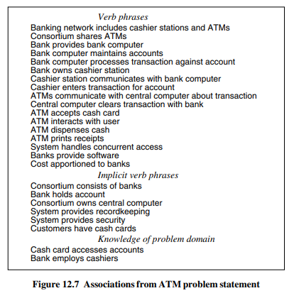
Finding associations
Notes:
Associations from ATM problem statement.

Slide 18
Keeping the Right Associations
Discard unnecessary associations, using the following criteria:
Associations between eliminated classes.: If you have eliminated one of the classes in the association, you must eliminate the association or restate it in terms of other classes.
Irrelevant or implementation associations: Eliminate any associations that are outside the problem domain or deal with implementation constructs.
Actions: An association should describe a structural property of the application domain not a transient event.
Ternary associations: You can decompose most associations among three or more classes into binary associations or phrase them as qualified associations Ex: Association Company pays salary to person can be rephrased as binary association Company employs person with a salary value for each Company-Person link.
Derived associations :they may be redundant

Slide 19
Keeping the Right Associations
Further specify the semantics of associations as follows:
Misnamed associations: Names are important to understanding and should be chosen with great care. ATM example. Bank computer maintains accounts is a statement of action; rephrase as Bank holds account
Association end names: Add association end names where appropriate. For example, in the WorksFor association a Company is an employer with respect to a Person and a Person is an employee with respect to a Company.
Qualified associations: ATM example. The qualifier bankCode distinguishes the different banks in a consortium. Each cash card needs a bank code so that transactions can be directed to the appropriate bank
Multiplicity:Specify multiplicity if needed.
Missing associations: Add any missing associations that are discovered.
Aggregation: Aggregation is just an association with extra connotations. Use whichever seems more natural at the time and move on. ATM example. We decide that a Bank is a part of a Consortium and indicate the relationship with aggregation.
Fig 12.9 shows class diagram with remaining associations

Slide 20
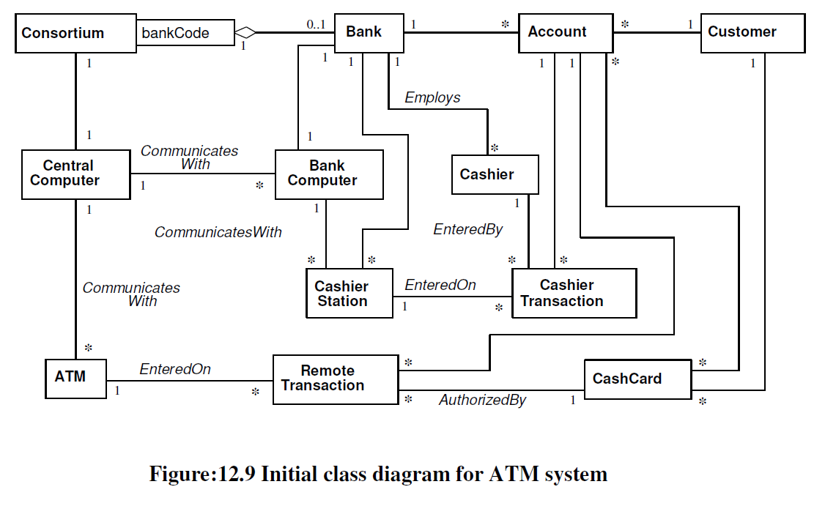
Finding associations

Slide 21
Find attributes
Find attributes of objects and links.
Attributes are data properties of objects
Attribute values should not be objects; use an association to show any relationship between objects.
Attributes usually correspond to nouns followed by possessive phrases, such as “the color of the car” or “the position of the cursor.”

Slide 22
Keeping the right attributes:
Eliminate unnecessary and incorrect attributed with the following criteria:
Objects
Qualifiers
Names
Identifiers
Attributes on associations
Internal values
Fine detail
Discordant attributes
Boolean attributes.

Slide 23
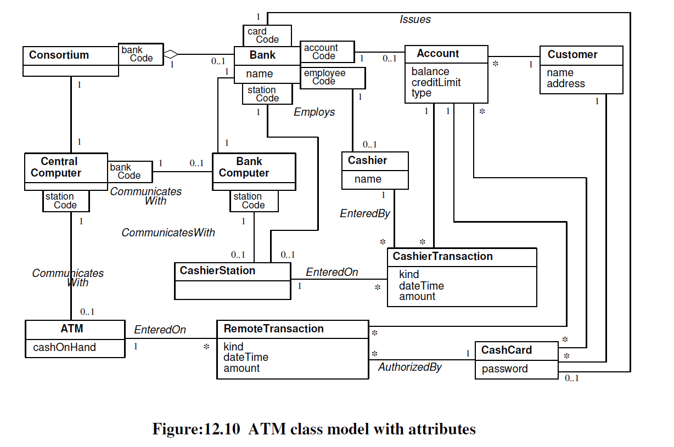

Slide 24
Refining With Inheritance
Organize classes by using inheritance to share common features:
Bottom up generalization.
Top-down generalization
Generalization vs. enumeration.
Multiple inheritance
Similar associations
Adjusting the inheritance level.
Fig 12.11 shows the ATM class model after adding inheritance

Slide 25
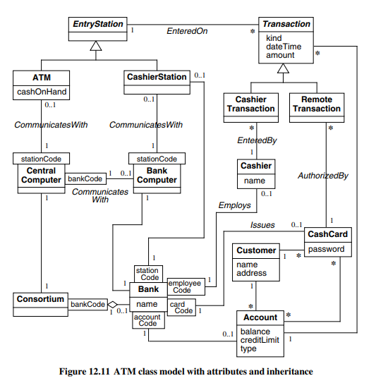

Slide 26
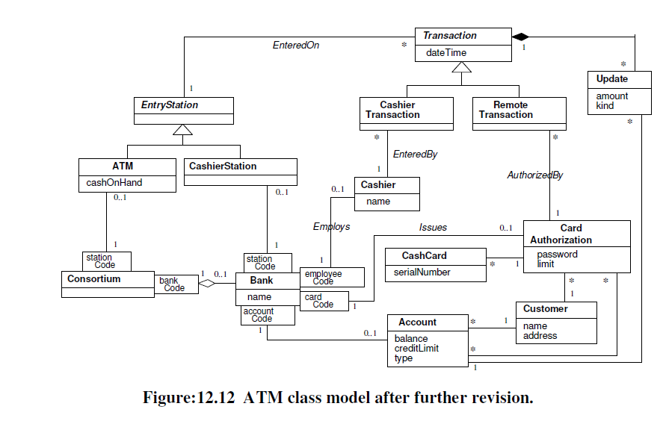
Refining With Inheritance

Slide 27
Testing Access Paths
Verify that access paths exist for likely queries.
Trace access paths through the class model to see if they yield sensible results

Slide 28
Iterating a Class Model
A class model is rarely correct after a single pass, so iterate and refine the model
If you find a deficiency, go back to an earlier stage if necessary to correct it
There are several signs of missing classes.
Asymmetries in associations and generalizations. Add new classes by analogy.
Disparate attributes and operations on a class. Split a class so that each part is coherent.
Difficulty in generalizing cleanly. One class may be playing two roles. Split it up and one part may then fit in cleanly.
Duplicate associations with the same name and purpose. Generalize to create the missing superclass that unites them.
A role that substantially shapes the semantics of a class. Maybe it should be a separate class. This often means converting an association into a class.

Slide 29
Iterating a Class Model
Also look out for missing associations.
Missing access paths for operations. Add new associations so that you can answer queries.
Another concern is superfluous model elements.
Lack of attributes, operations, and associations on a class. Why is the class needed? Avoid inventing subclasses merely to indicate an enumeration. If proposed subclasses are otherwise identical, mark the distinction using an attribute.
Redundant information. Remove associations that do not add new information or mark them as derived.
And finally you may adjust the placement of attributes and associations.
Association end names that are too broad or too narrow for their classes. Move the association up or down in the class hierarchy.
Need to access an object by one of its attribute values. Consider a qualified association.

Slide 30
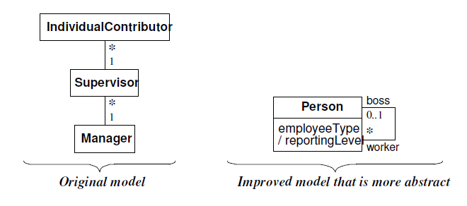
Reconsider the level of abstraction.
Abstraction makes a model more complex but can increase flexibility and reduce the number of classes.

Slide 31
Group classes into packages.
The last step of class modeling is to group classes into packages.
A package is a group of elements(classes, association, generalizations and lesser packages) with common theme.
Normally you should restrict each association to a single package, but you can repeat some classes in different packages.
Reuse a package from a previous design if possible, but avoid forcing a fit. Reuse is easiest when part of the problem domain matches a previous problem
ATM example: The packages might be:
Tellers(a person employed to deal with customers transaction in a bank)—cashier, entry station, cashier station, ATM
accounts—account, cash card, card authorization, customer, transaction, update, cashier transaction, remote transaction
banks—consortium, bank

Slide 32
Domain State Model
The Following steps are performed in constructing a domain state model
Identifying classes with states
Finding states
Finding Events
Building state diagrams
Evaluating state diagrams

Slide 33
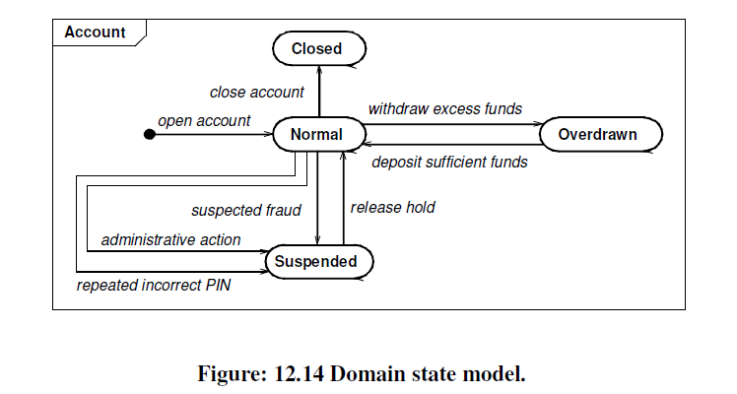
Domain State Model

Slide 34
Domain Interaction Model
The Interaction model is seldom(rarely) important for domain analysis.
The Interaction model is an important aspect of application modeling

Slide 35
Iterating the Analysis
To understand a problem with all its implications, you must attack the analysis iteratively, preparing a first approximation to the model and then iterating the analysis as your understanding increases
The iteration to the analysis should be done as follows:
Refining the Analysis Model
Restating the Requirements
Analysis and Design.

Slide 36
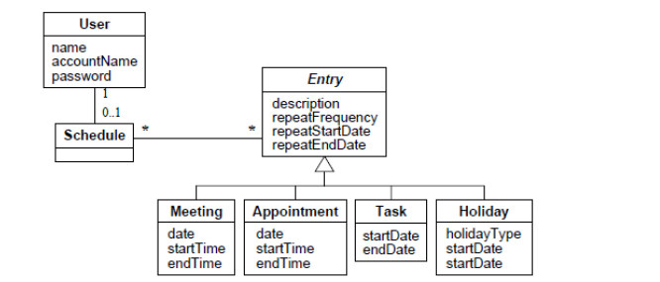
Example: The following is the class model for the scheduler software:
Identify all classes and list the possible classes to be eliminated

Slide 37
Example: The following is the class model for the scheduler software
All classes
Scheduling software, meeting user, chairperson, software, meeting entry, schedule, attendee, scheduler, room, time, everyone, attendance, acceptance status, meeting notice, invitation, meeting information, invitee, notice

Slide 38
Classes elimination
The following tentative classes should be eliminated.
Redundant classes.
Invitee is synonymous with user and could be a role, depending on the realization of the class model. Everyone refers to user and is redundant.
Meeting notice is the same as notice; we keep notice.
Attendance is also extraneous and merely refers to an attendee participating in a meeting. Meeting and meeting entry are synonymous; we keep meeting.
Irrelevant or vague classes.
We discard scheduling software, scheduler, software, and meeting information because they are irrelevant.
Attributes.
We model time and acceptance status as attributes. An invitation is a type of notice; we need the enumeration attribute notice Type to record whether an invitation is an invitation, reschedule, cancellation, refusal, or confirmation.
Roles. Chair person and attendee are association ends for user.

Slide 39
THANK YOU

